Slide 1
PrEDICTING THE POPULARITY OF BOOK REVIEWS
SC1015-Mini Project
JOANNE CHRISTINA SALIMIN (U2120304J)
NITHYA HARIHARAN (U2123872G) VARSHA BALAJI (U2123383L)

Slide 2
01.
Practical motivation and problem definition

Slide 3
Book publishers
Poor working conditions
When 349 publishing employees are surveyed, they found out that the publishing is highly qualified, and predominantly unpaid for overtime
LOW WAGES
Yearly wage is as low as $45,000 compared to an average full-time Australian salary of about $80,000, and is unlikely to increase as you progress

Slide 4


Plausible reason: general decline in book sales.
SALES WERE DOWN IN: U.S BY 9.8%, SOUTH AFRICA 8.8%, sPAIN 10.8%, australia by 13.2%...

Slide 5

PRActicAL Motivation
Decline in sales of books due to a lack of interest affects the livelihood of those working in the industry
Popular book reviews can stimulate reading interest, thus increasing sales, and improve the livelihood of workers in the industry

Slide 6

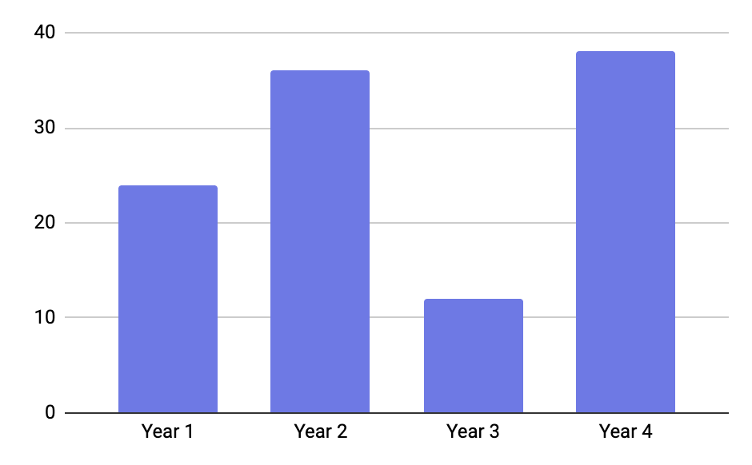


MOTIVATIoN BEHIND OUR DATASET
DATASET
WHY THIS DATASET?
Goodread is the most popular site when it comes users looking for books reviews
Has amassed over 90 million members in July 2019
Goodreads book review dataset
DATASET:
Goodreads book review dataset
Follow the link in the graph to modify its data and then paste the new one here. For more info, click here

Slide 7
02.
Data scraping

Slide 8

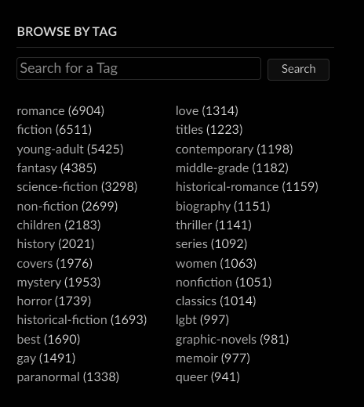
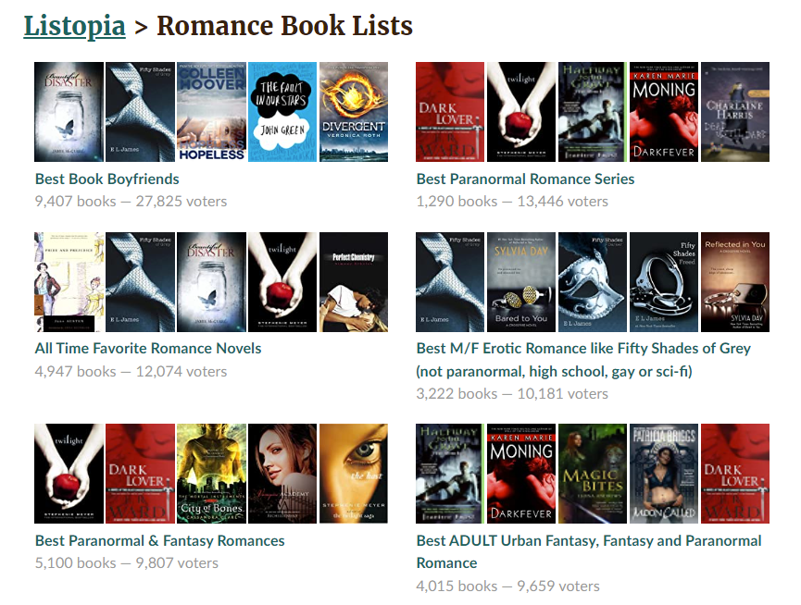
Web Scraping
BeautifulSoup and Selenium is used.
Scrape through all the books that is contained inside a list that contains the 30 top-rated tags (according to Goodreads)

Slide 9
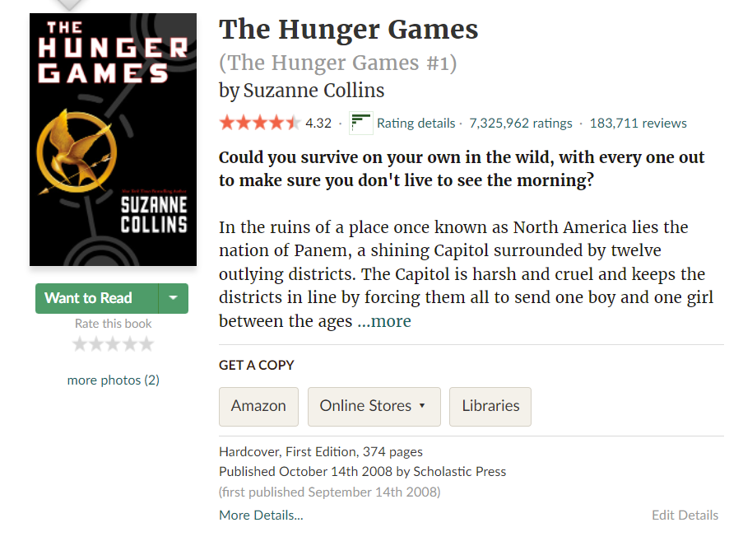

FOR EACH BOOK, THESE DATA ARE TAKEN
Book_ID : Unique sequence of number given to each book
Book_Title : Title of the book
Author_Name : Name of the book’s author
Num_Ratings : Total numbers of rating
Average_Ratings : The overall rating given to the book
Num_Review : Total number of reviews

Slide 10
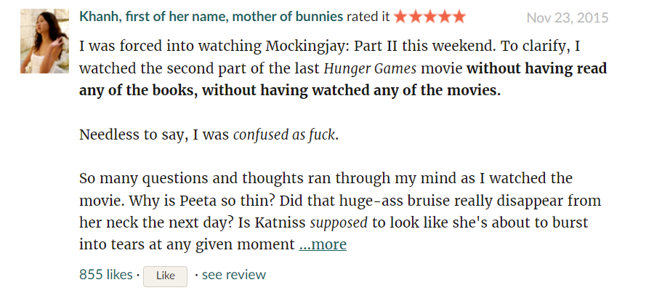
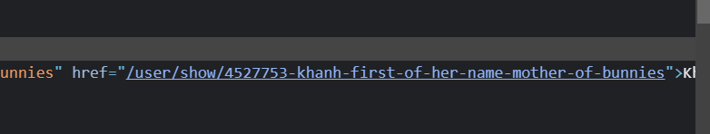
FOR EACH REVIEW, THESE DATA ARE TAKEN
Review : The content of each review
Stars_Ratings : The rating each review gives to the book
Likes_Count : The number of likes each review receives
User_ID : Unique sequence of number given to each user

Slide 11

11,902,156 data is collected

Slide 12
03.
DATA CLEANING

Slide 13
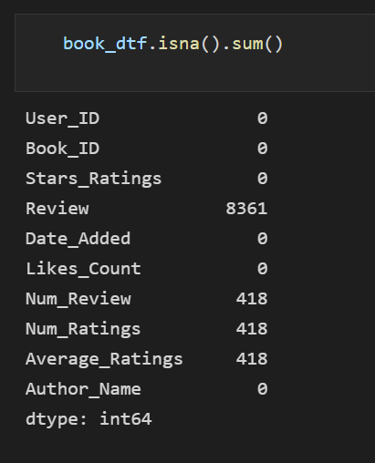
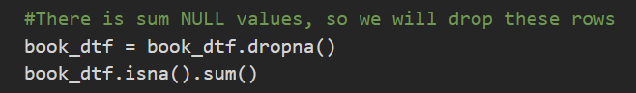
Filtering out null data
Rows that has null data is removed from the dataset

Slide 14
2. FILTERING OUT NOT-POPULAR BOOKS
Since we want to predict if a review is a popular review enough we need to find:
Books that have enough number of reader in order to assess popularity
Else we are unable to determine if the reviews are unpopular or merely unseen by other users. Unpopular books will therefore be removed from the dataset.
A book’s popularity is assessed based on the total number of reviews, and the total number of likes, summed from each book review received by a particular book.

Slide 15
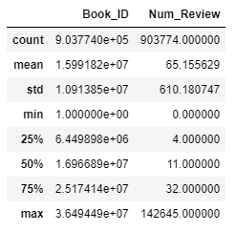
METHOD TO FILTER OUT NOT-POPULAR BOOKS
Analysis was conducted on total number of review
There’s a huge standard deviation for the variable Num_Review, so to really make sure that only books with sufficient amount of popularity is considered, books with less than Q3 value of Num_Reviews (32) is removed.

Slide 16
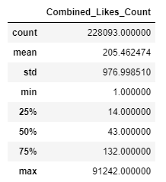
METHOD TO FILTER OUT NOT-POPULAR BOOKS
Analysis was conducted on total number of likes
A new variable Combined_Likes_Count is made by summing up all the Likes_Count of each book
There’s also a huge standard deviation between each book’s Combined_Likes_Count, books with values less than the median of Combined_Likes_Count (43) will be dropped.
Here we use median value instead of the third quartile value is because this analysis is done after dropping the book based on their Num_Reviews
Using Q3 value of Combined_Likes_Count as a basis to drop the book will result in too much data loss

Slide 17
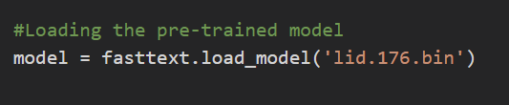
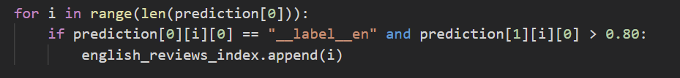
3. Filtering out non-English reviews
The library fasttext, and a pre-made model (lid.176.bin) is used in order to determine whether a review is written in English or not.
Only reviews with 80% surety of it being English is kept in our dataset

Slide 18
03.
DATA preparation

Slide 19

NEW vARIABLES ARE ADDED
Ratio : Likes of an individual review / Total number likes received by the book
Ratio is thus a measure of the relative popularity of the review and allows a fair comparison between reviews on different books with varying number of readers
Popularity : Determine whether a review is popular or not, will be assigned to 0 if its popular and 1 if it's unpopular
Popularity is determined by variable Ratio. If the ratio is higher than 0.02, review will be deemed as popular, else the review is unpopular.

Slide 20
NEW VARIABLES ARE ADDED
Diff_Ratings: Difference between rating given by individual user and overall book rating
Diff_Ratings = Stars_Rating - Average_Ratings

Slide 21

NEW VARIABLES ARE ADDED
Quote: Check if a book has quotes or not
This is done by checking if the book review has “ “ in it
User_Reviews: Total number of reviews created by each user
Count the number of reviews made by each user, based on the unique ID given to each user

Slide 22

NEW VARIABLES ARE ADDED
From Review, using nltk library:
List of sentences is extracted using nltk.tokenize.sent_tokenize
List of words is extracted using nltk.tokenize.word_tokenize
From these newly made columns, several new variable is created:
Num_Tokenized_Words : Number of words in a review
Average_WordLength : Average word length in a review
Average_WordsinSentence : Average words in a sentence

Slide 23
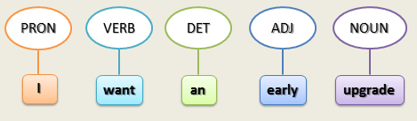
NEW VARIABLES ARE ADDED
Every word that was previously tokenized (list of words), is given a
POSTAG, using nltk.pos_tag
With respect to definition and context, a word is given a particular TAG
A list of tuple containing the word and the associated POSTAG will be returned

Slide 24
NEW VARIABLES ARE ADDED
Using the POSTAGS, these new variables are created:
Percentage_Verbs : Percentage of verbs in the review
Percentage_Nouns : Percentage of nouns in the review
Percentage_AdjAdverb : Percentage of adjective and adverbs in the review
Using the SentimentIntensityAnalyzer() function, a new variable is created:
Sentiment_Score : Sentiment Intensity value of each review
A positive number indicates that is a positive review, while a negative number indicates that is a negative review.

Slide 25
NEW VARIABLES ARE ADDED
Tokenized_Words: Contains the words in the review
The words in Tokenized_Words, are words extracted from nltk.tokenize.word_tokenize.
Stopwords (commonly used words) taken from nltk library is filtered out from Tokenized_Words in order to give more focus to important information.
Filtered out Tokenized_Words are then Lemmatized, using the nltk.stem.wordnet.WordNetLemmatizer() function.
Lemmatizer allows the grouping together of different inflected forms of a word so they can be analyzed as a single item, this is done in assistance to the POSTAG, so the function have a context of the word meaning.

Slide 26
04.
DATAset summary

Slide 27
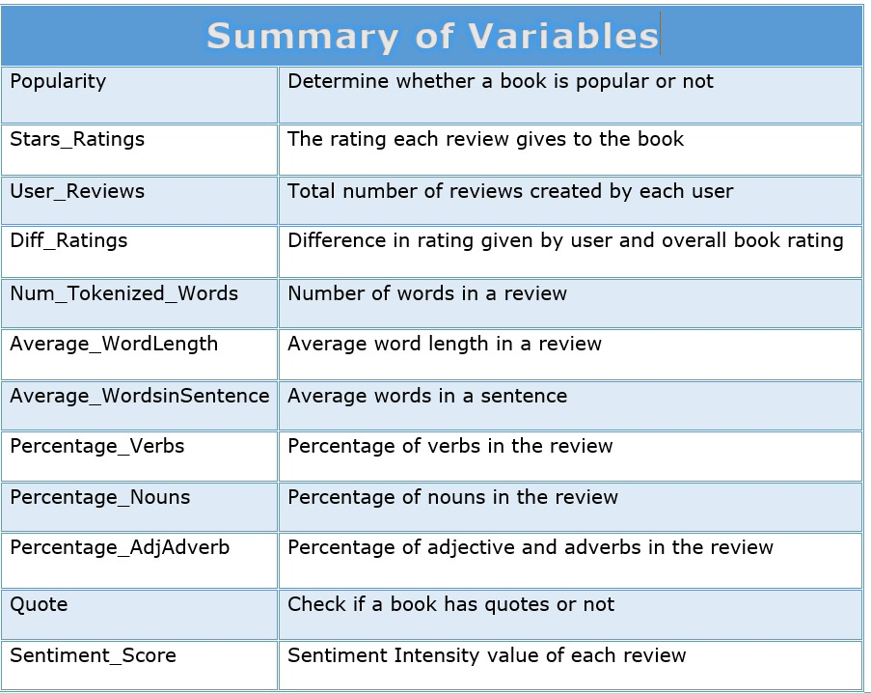

Slide 28
05.
EXPLORATORY DATA ANALYSIS

Slide 29
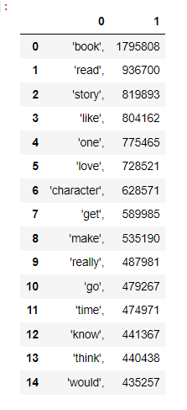
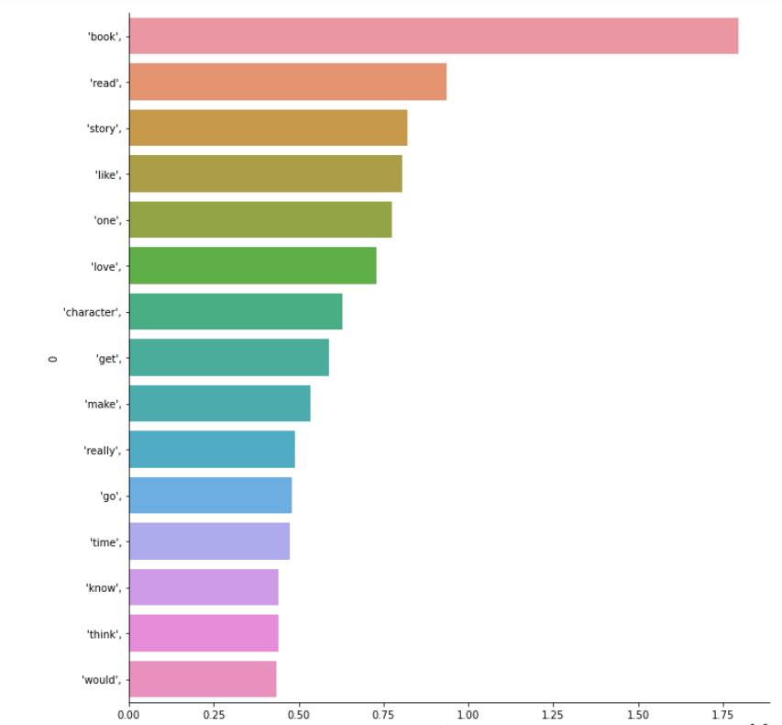
MOST USED WORDS WITH COUNT

Slide 30
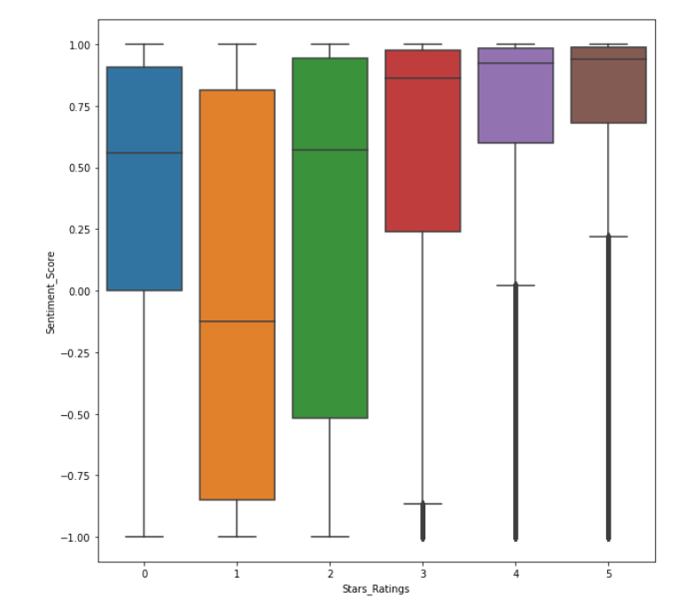
2. RELATIONSHIP BETWEEN SENTIMENT SCORE AND STARS RATING

Slide 31
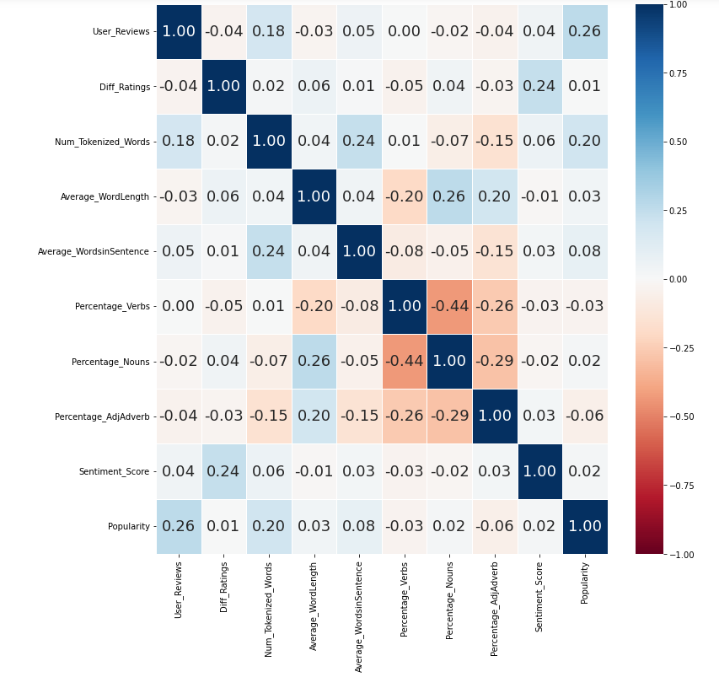
3. ANALYZING THE NUMERICAL VARIABLES

Slide 32
06.
Machine learning
models

Slide 33

CLASSIFICATION
NON-TEXTUAL
TEXTUAL
Non-textual
And textual
We try to determine a review popularity based on three categories:
Number of reviews, User rating, Difference between average and user rating
Word length of Review, Percentage of nouns, adjectives, verbs, Average word and sentence length, Quote, Sentiment
Combination of Non-textual and textual variables

Slide 34
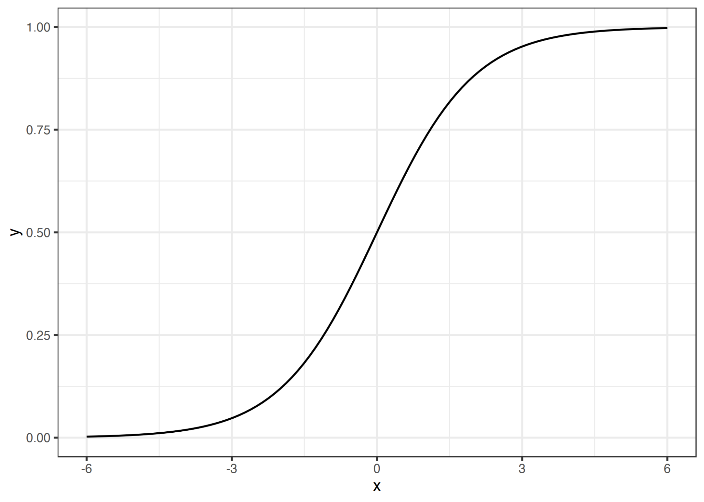

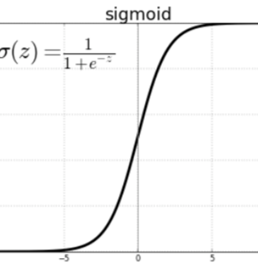

Two models used
LOGISTIC regression
xgboost

Slide 35
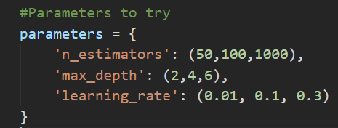
HOW MODEL IS OPTIMIZED - XGBOOST
GridSearchCV is used to loop through all the predefined parameters, and use it to fit on the training set. This way, the best parameters can be applied.

Slide 36
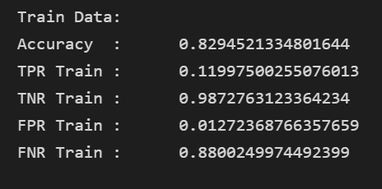
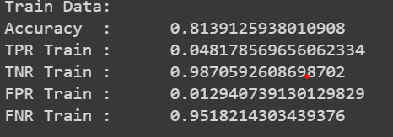
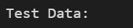

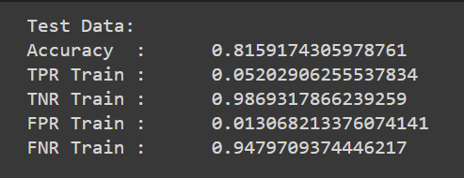
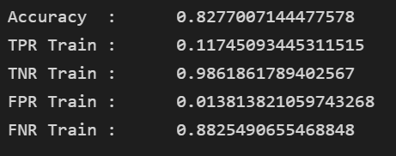
TRAIN-TEST set FOR non-TEXTUAL prediction
XGBOOST
LOGISTIC REGRESSION

Slide 37
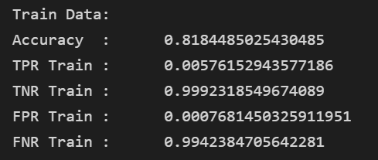
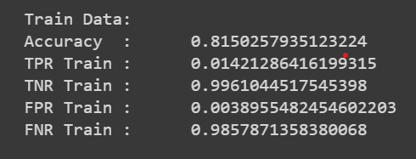
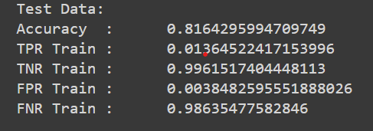
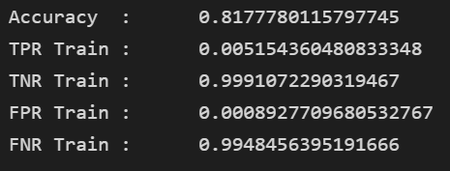
TRAIN-TEST set FOR TEXTUAL prediction
XGBOOST
LOGISTIC REGRESSION

Slide 38
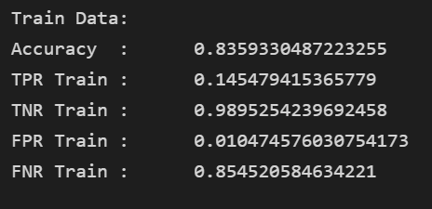
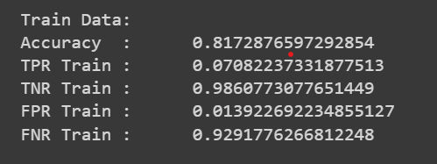
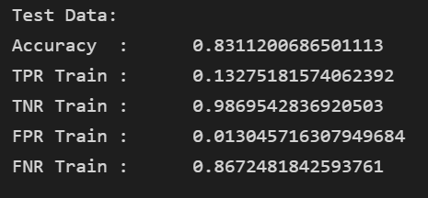
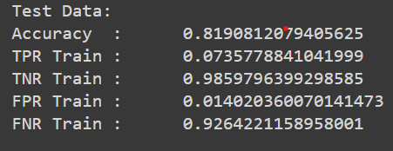
TRAIN-TEST set FOR TEXTUAL + non-textual prediction
XGBOOST
LOGISTIC REGRESSION

Slide 39
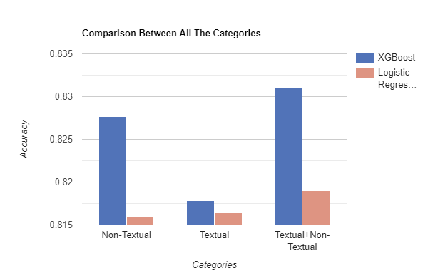
Evaluation
Best category for prediction is by using Textual + Non-Textual data
XGBoost gives a better accuracy for all three categories

Slide 40
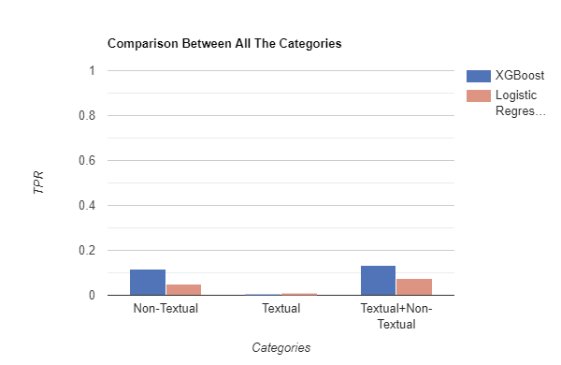
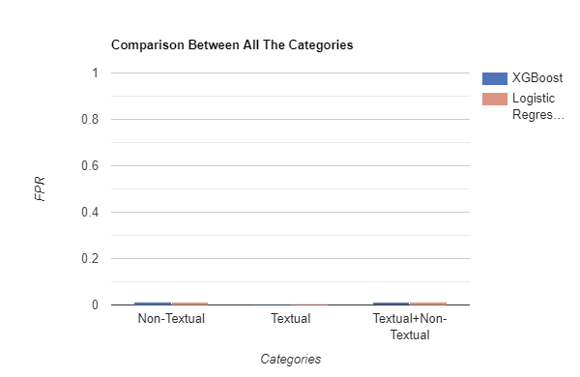
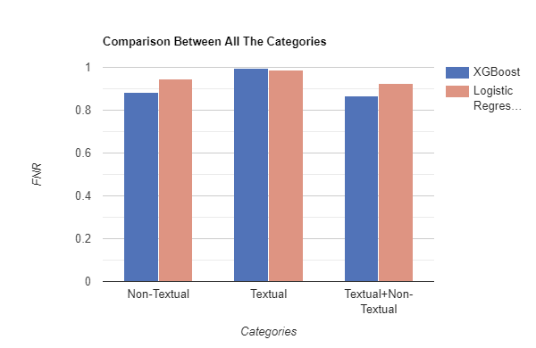
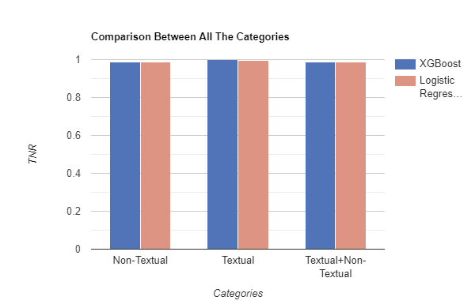
Evaluation
BAD AT PREDICTING POPULAR REVIEWS - HIGH FALSE NEGATIVE, LOW TRUE POSITIVE
GOOD AT PREDICTING UNPOPULAR REVIEWS - high true negative, low false positive

Slide 41
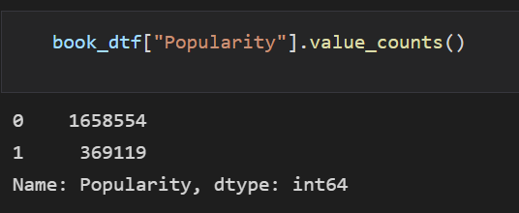
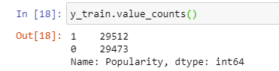
undersampling
Potential reason between the big difference in accuracy in predicting Popular compared to Unpopular reviews:
To combat this potential problem, undersampling is used, such that sample size of popular and unpopular reviews is mostly the same
The same seed value is used when we undersample them, to make sure we’re working on the same train and test set.

Slide 42
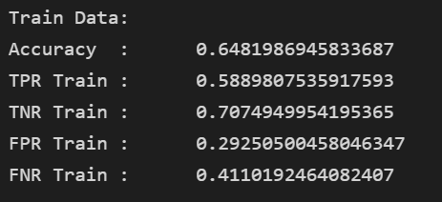
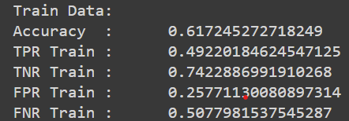
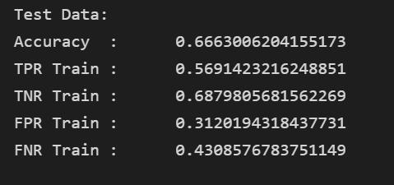
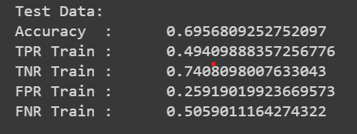
Undersampling - Non-textual prediction
XGBOOST
LOGISTIC REGRESSION

Slide 43
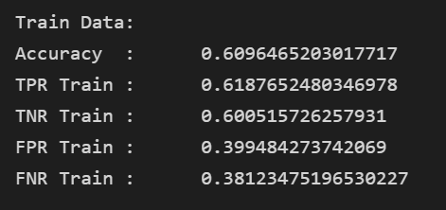
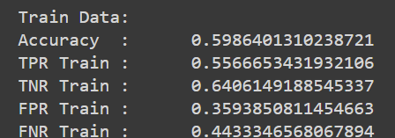
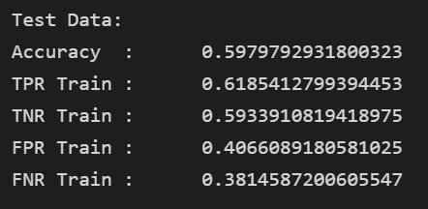
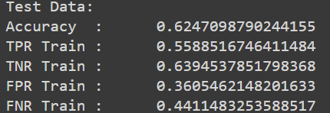
Undersampling - textual prediction
XGBOOST
LOGISTIC REGRESSION

Slide 44
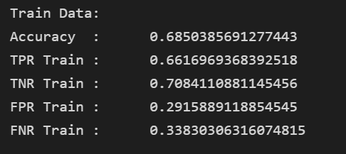



Undersampling - TEXTUAL + NON-TEXTUAL
XGBOOST
LOGISTIC REGRESSION

Slide 45

COMPARISON - UNDERSAMPLING
Best category is now Non-Textual
Logistic Regression is now doing better than XGBoost.
This might be because XGBoost works best on larger dataset (larger train size)

Slide 46


COMPARISON - UNDERSAMPLING AND NOT_UNDERSAMPLED
For both XGBoost and Logistic Regression, accuracy is higher when it is not undersampled.

Slide 47




COMPARISON - UNDERSAMPLING AND NOT_UNDERSAMPLED
LOWER FN WHEN IT IS NOT UNDERSAMPLED
UNDERSAMPLING MAKES THE MODEL BETTER
AT PREDICTING POPULAR REVIEWS
Higher fp when it is undersampled

Slide 48



COMPARISON - UNDERSAMPLING AND NOT_UNDERSAMPLED
Higher FP WHEN IT UNDERSAMPLED
UNDERSAMPLING MAKES THE MODEL WORSE AT PREDICTING unPOPULAR REVIEWS
LOWER TN WHEN IT IS UNDERSAMPLED

Slide 49

REASON WHY UNDERSAMPLING ACCURACY IS LOWER
Test dataset has more unpopular review than popular review.
Since our undersampled model predicts popular review better, whilst our not_undersampled model predicts unpopular review better, the undersampled data thus have lower accuracy due to this bias.

Slide 50
06.
CONCLUSION

Slide 51
OUTCOME OF THE PROJECT
Using our Machine Learning Model, we can:
Modify variable and predict what changes can be made to identify if the review is popular or not
Predict potential popular book reviews with positive sentiment score and put it in the front page of GoodReads to receive increased interest in reader for that particular book
Book reviewers can understand better how to create reviews that would help support their favourite book/author

Slide 52
WHICH MODEL AND CATEGORY OF DATA TO USE?
Given an unknown dataset, it is best to use Logistic Regression with an undersampled Non-Textual data.
This model works generally well for predicting both popular and unpopular reviews.
Unlike XGBoost and Logistic Regression with non-undersampled, the probability that a popular review will be predicted properly is only approximately 10%. However this recommended model and category not only manage to have a increased success rate from 10% to 60% in predicting popular review, although decreased, has managed to maintain a moderate accuracy of 60% for predicting unpopular review as well.

Slide 53

DATA DRIVEN INSIGHTS
Thus, how popular is the user who makes the review is the most deciding factor that contributes if the review is going to be popular or not
Based on EDA, User_Reviews (Number of reviews a user writes) is the numerical variable that has the highest correlation with Popularity. Their strong correlation is confirmed once more when User_Review receive the highest Importance_Score in XGBoost.
The higher the importance score, means the
more the attribute is used to make key
decision with decision tree.

Slide 54

DATA DRIVEN INSIGHTS
Another important feature is the review length, seen by suggesting that the longer the review, the better. It perhaps gives the reader more substance to like and comment on.
This can be seen from the second numerical
highest correlation (0.2) from the EDA, and the
highest importance score from XGBoost when
only textual data is used.

Slide 55

THANKS

